Slide 1

ENGINEERING CHEMISTRY
HARISH N
9738889242
Department of Science and Humanities

Slide 2

ENGINEERING CHEMISTRY Module VI- Electrochemical Sensors
Module Content :
Classification of sensors
Types of Electrochemical Sensors
Electrochemical Sensors: Gas Sensor- O₂ Sensor
Biosensors- Glucose Sensor

Slide 3
ENGINEERING CHEMISTRY
Module VI- Electrochemical Sensors
Class Content :
Classification of sensors
Types of Electrochemical Sensors

Slide 4
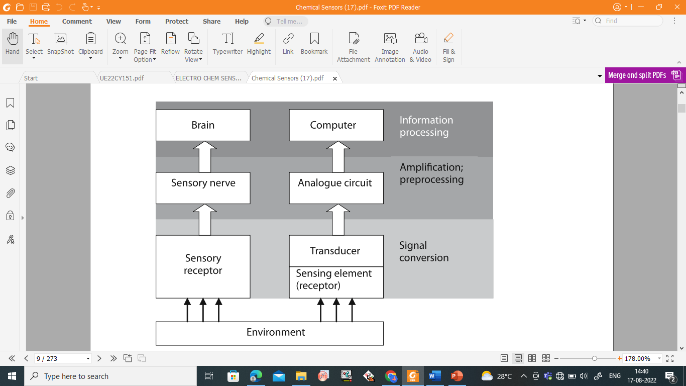
ENGINEERING CHEMISTRY
Module VI- Electrochemical Sensors
SENSORS: A sensor is a device that detects and responds to some type of input from the physical environment.
The specific input could be light, heat, motion, moisture, pressure, or can be any molecule or substance such as analytes.
Signal processing in living organisms and in intelligent machines

Slide 5
TYPES OF SENSORS
ENGINEERING CHEMISTRY
Module VI- Electrochemical Sensors
Sl No | Types of Sensors | Monitored property | Examples
1 | Electrochemical Sensors Potentiometric Sensors Amperometric Sensors | Potentiometric -Voltage Amperometric- Current | Potentiometric- Ion selective electrode-pH sensor-Glass electrode/ Oxygen Sensor Amperometric- Biosensors- Glucose sensors (measures current)
2 | Mass-Sensitive Sensors | Mass Sensing | Piezoelectric material –Quartz Crystal microbalance, piezoresistive- Silicon Carbide
3 | Conductivity Sensors | Conductance (Resistance Sensing) | Platinum electrode – Probe with two electrode(Pt)
4 | Capacitive Sensors | Capacitance (Potential Load Sensing) | Touchscreens- glass/polyester/polycarbonate/polyethylene

Slide 6
ENGINEERING CHEMISTRY
Module VI- Electrochemical Sensors
TYPES OF SENSORS
Sl No | Types of Sensors | Monitored property | Examples
5 | Thermometric Sensors | Heat Sensing | Thermistors- Semiconductors (ceramics/polymers), Thermocouple-iron-constantan&copper-constantan Alloys Resistance Temperature Detectors (RTDs)- Platinum metal RTDs
6 | Calorimetric Sensors | Enthalpy Change/ Heat transfer | Differential Scanning Calorimetry (DSC)- Thermocouples-metal/metal alloys (Pt-Pt/Rh) /(Ni-Cr/Ni-Al) Microcalorimeters- Aluminium, steel, Quartz.
7 | Optical Sensors | Photon/Light | Photo detectors- photodiodes and phototransistors Optical fibre sensor- silica glass/Plastic Optical fibres ( POFs), Gallium Arsinide, Ge-Si Solar Cells

Slide 7
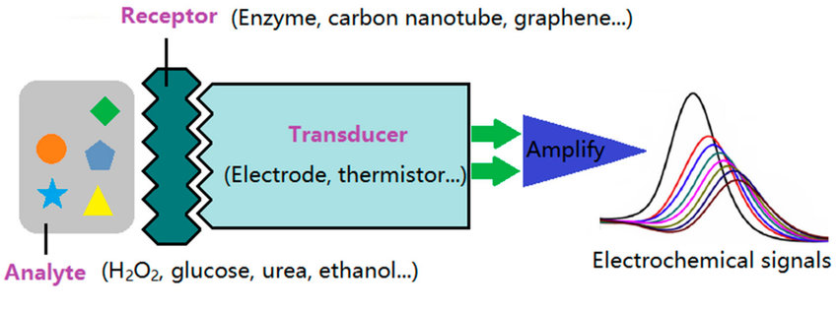
ENGINEERING CHEMISTRY
Module VI- Electrochemical Sensors
ELECTROCHEMICAL SENSORS: A class of chemical sensors in which an electrode is used as a transducer element in the presence of an analyte.
Electrochemical sensors transfers the effect of the electrochemical interaction of the analyte-electrode into a useful electric signal.
https://www.researchgate.net/publication/335398612_Electrochemical_Sensors_Fabricated_by_Electrospinning_Technology_An_Overview

Slide 8
ENGINEERING CHEMISTRY
Module VI- Electrochemical Sensors
Types of Electrochemical Sensors
Potentiometric Sensors
Amperometric Sensors

Slide 9
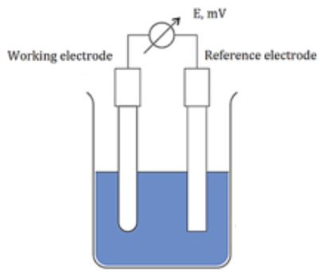
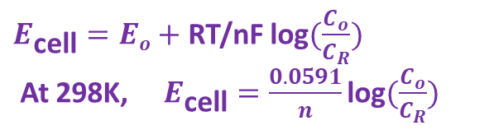
ENGINEERING CHEMISTRY
Module VI- Electrochemical Sensors
TYPES OF ELECTROCHEMICAL SENSORS
POTENTIOMETRIC SENSORS
Sensors that use the effect of concentration on the equilibrium of redox reactions occurring at the electrode-electrolyte interface of an electrochemical cell.
The redox reaction takes place on the electrode surface:
Oxidant + ne⁻ → Reduced product
Mainly determine the analyte
concentration by measuring the
variation of potential difference
between working and reference
electrodes at different analyte
concentrations.
$E_{\text{cell}}=Eo+$ RT/nF $\text{log}(\frac{C_{o}}{C_{R}})$
At 298K, $E_{\text{cell}}=\frac{0.0591}{n}\text{log}(\frac{C_{o}}{C_{R}})$

Slide 10
ENGINEERING CHEMISTRY
Module VI- Electrochemical Sensors
Examples of Potentiometric Sensors
Ion Selective Electrode Sensors
Glass electrodes (e.g. pH-meter, Na⁺, K⁺, Li⁺ Sensors
Solid membrane electrodes (e.g. based on AgX for X⁻, and Ag₂S for other M⁺).- Liquid membrane electrodes (e.g. containing a ligand for M+ complexation e.g. Ca²⁺ and K⁺ sensors).
Gas Potentiometric Sensors
pH-meter-based gas detectors (e.g. CO₂, NH₃ etc).
Solid oxide sensors (e.g. zirconia-based O₂ sensor (λ-sensor)
Source: http://photobiology.info/Visser-Rolinski.html

Slide 11
ENGINEERING CHEMISTRY
Module VI- Electrochemical Sensors
Potentiometric sensors
Advantages
Applied to detect various analytes qualitatively and quantitatively.
Easy to Construct and operate, more accuracy, sensitive and highly selective determination
Smaller Volumes of analytes can be estimated
Economically Viable
Limitations
Requires calibration During estimation
In Presence of other impurities can affect the potential Values
By varying the temperature potential values also varies.

Slide 12
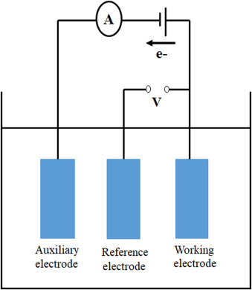
ENGINEERING CHEMISTRY
Module VI- Electrochemical Sensors
AMPEROMETRIC SENSORS
Measure the current in response to detect the concentration of the analyte at a fixed potential.
The applied potential drives the electron transfer reaction of the analytes, and the measured current indicates the analyte concentration.
Amperometric sensors quantify the current output between Working and the reference electrode. The sensor is usually composed of 3 electrodes, that is working, auxiliary, and reference electrode

Slide 13
Working of Amperometric Sensors
ENGINEERING CHEMISTRY
Module VI- Electrochemical Sensors
The working electrode is the electrode at which the reaction of interest occurs, the reference electrode (e.g.; Ag/AgCl, Hg/Hg₂Cl₂) provides a stable potential compared to the working electrode.
An inert conducting material (e.g.; platinum, graphite) is usually used as auxiliary electrode.
A supporting electrolyte is used in controlled-potential experiments to eliminate electromigration effects, decrease the resistance of the solution and maintain the ionic strength constant.

Slide 14
Advantages and limitations of amperometric sensors
ENGINEERING CHEMISTRY
Module VI- Electrochemical Sensors
ADVANTAGES | LIMITATIONS
It can be used for estimation of reducible and non-reducible (Mg^{2+,} PO₄³⁻, SO₄²⁻ ) analytes | Working potential applied should be for limited time or may lead to damage of the electrode
More accurate and sensitive | Coprecipitation gives inaccurate results
Traces of reducible species can be determined accurately | These sensors cannot be used with applied voltage more negative than -2V because hydrogen will be evolved
Simple to operate and Easy to Construct | Consumes more time to remove dissolved oxygen

Slide 15
THANK YOU
HARISH N
9738889242
Department of Science and Humanities

